Slide 1
Presentation Guidelines
Here you’ll find guidelines for designing your Xamarin Evolve 2014 presentations.
White slides with “GUIDELINES” in the lower right corner are not sample slides for use in your presentations – please hide or delete guideline slides.
You’ll also find icons and device frames for use on your slides in the guidelines.
Notes:
All guidelines slides should also be present in the PowerPoint version.

Slide 2
Presentation Fonts
We are using Segoe UI for normal text. Download Segoe UI:
https://www.dropbox.com/s/hpkow9i6398jm04/Segoe.zip
We are using Menlo for code. Download Menlo:
https://www.dropbox.com/s/c0r9812b67dy1ay/Menlo.ttc
Title uses Segoe UI 110pt
Section headings use Segoe UI 130pt
Subtitles use Segoe UI 60pt
Content uses Segoe UI 45pt
Big number slides use Helvetica light 280pt
Quotations use Segoe UI 62pt.
Notes:
Add to PowerPoint: Windows users should use Consolas for code.

Slide 3
Color Palette
Light blue
R 59 G 153 B 212
Hex #3B99D4
R 118 G 130 B 130
Hex #768282
Grey
Dark blue
R 21 G48 B 78
Hex #15304E
Blue Grey dark
R 43 G 62 B 80
Hex #2B3E50
R 169 G 86 B 160
Hex #A956A0
Grey 2 Dark
R 226 G 231 B 231
Hex #E2E7E7
Purple
R 126 G 195 B 104
Hex #7EC368
Grey 2 Light
R 236 G 240 B 241
Hex #ECF0F1
Green

Slide 4
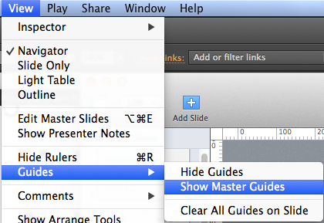
Use the grid to align slides nicely
The grid guides are in the master slide.
Click Keynote View menu a long on the top, and then go to Guides, and select Show Master Guides
If you want to hide the grid guides, select Hide Master Guides in the same menu.
Notes:
Please include equivalent alignment suggestions for PowerPoint (is there a grid?)

Slide 5
Using the Evolve logo
Our logo=Xamarin logotype + Evolve logotype
Minimum size
Logo
On-screen 150px
Xamarin logotype
Evolve logotype
Clear space
X
X
X
X

Slide 6

Using the Evolve logo on color backgrounds
The full-color logo may be placed on any of the colors shown here or on simple areas of photographs.
R 59 G 153 B 212 Hex #3B99D4
R 126 G 195 B 104 Hex #7EC368
R 226 G 231 B 231 Hex #E2E7E7
R 21 G48 B 78 Hex #15304E
R 118 G 130 B 130 Hex #768282
R 236 G 240 B 241 Hex #ECF0F1
R 169 G 86 B 160 Hex #A956A0
R 43 G 62 B 80 Hex #2B3E50

Slide 7


Using the Evolve logo
Don’t place the logo on backgrounds that provide insufficient contrast
Don’t add effects like shadows, dimensions, and gradients to the logo
Don’t place the logo over busy photographic background
Partner Program
Don’t create logo “lockups” by adding text in close proximity to the logo
Don’t stretch the logo
Don’t compress the logo

Slide 8
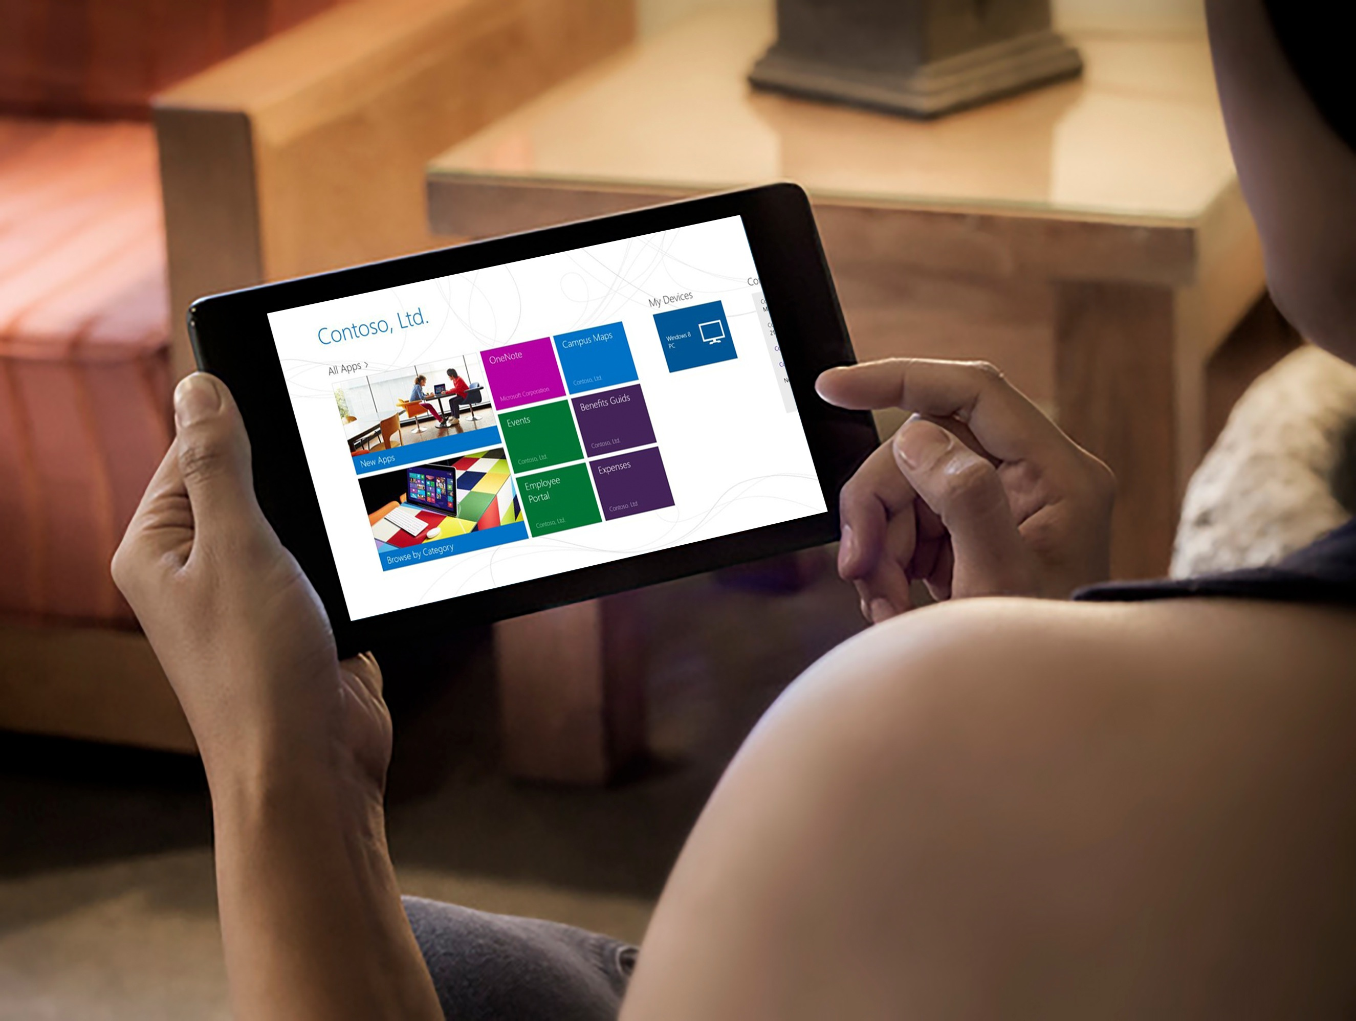
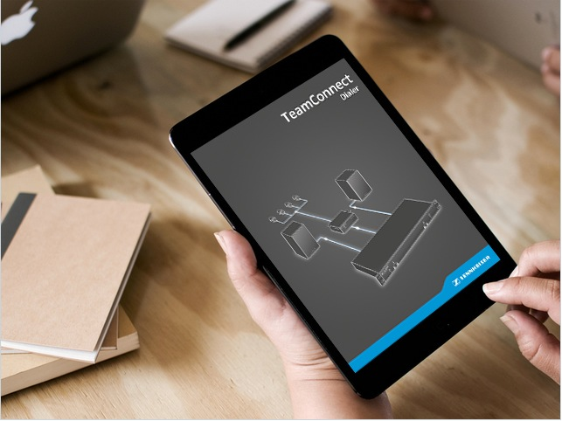

Example: layout three photos
Design Tip: In this instruction, turn on the drawing guides (View -> Guides) to see how the photos and content tiles are aligned to the underlying grid system.
This text shape has no fill. It uses the same default interior margins as content tiles
Align all text blocks to the content tiles interior margins
Text can be used on, above or below photos.

Slide 9
Photo Selection – Phone Screenshot
Replace devices screens
Use Placeit to find the background image for your app.
Photo Selection – Tablet Screenshot
Replace devices screens
Use Placeit to find the background image for your app.

Slide 10

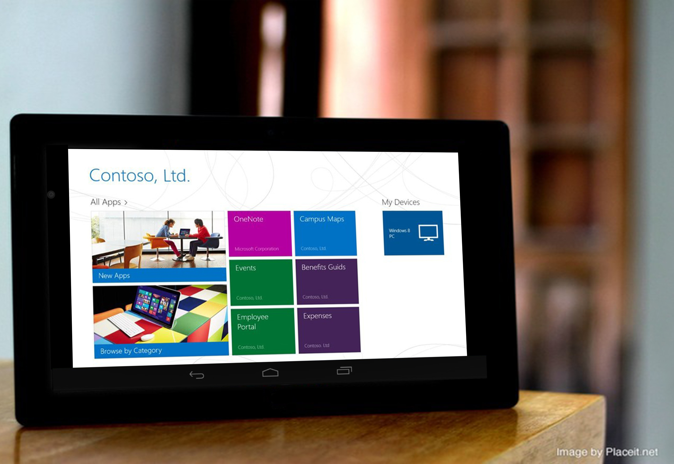
Using device frames
Replace screens with your own full-resolution screenshots.
Use www.placeit.net to generate in natura device shots.

Slide 11
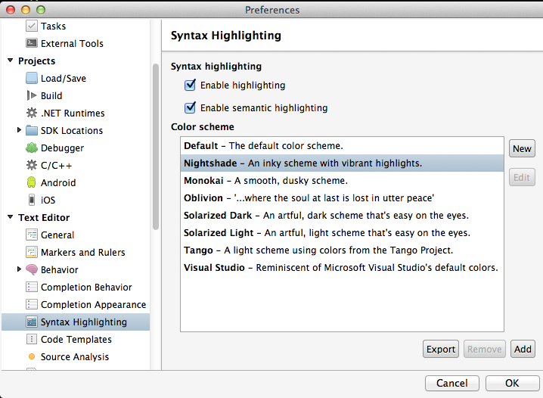
Formatting code
Make sure Xamarin Studio is using the Nightshade colorscheme.
Keep snippets short.
font: Menlo Regular
size: 30pt
line spacing: 1.2

Slide 12
Sample: Pretty code
public override void OnViewCreated (View view, Bundle savedInstanceState) { base.OnViewCreated (view, savedInstanceState);
ListView.DividerHeight = 0; ListView.Divider = null; ListAdapter = new GroceryListAdapter (view.Context, _order.Products);
if (ListAdapter.Count == 0) { checkoutButton.Visibility = ViewStates.Invisible;
} }
Notes:
This should be Consolas on Windows.

Slide 13
Use separate slides to call out sub-snippets
public override void OnViewCreated (View view, Bundle savedInstanceState) { base.OnViewCreated (view, savedInstanceState);
ListView.DividerHeight = 0; ListView.Divider = null; ListAdapter = new GroceryListAdapter (view.Context, _order.Products);
if (ListAdapter.Count == 0) { checkoutButton.Visibility = ViewStates.Invisible;
} }
Notes:
Here, two semitransparent boxes create a fade effect to deemphasize some line, while a bright box is used to add emphasis to a few lines. This is a better approach than using line numbers.

Slide 14
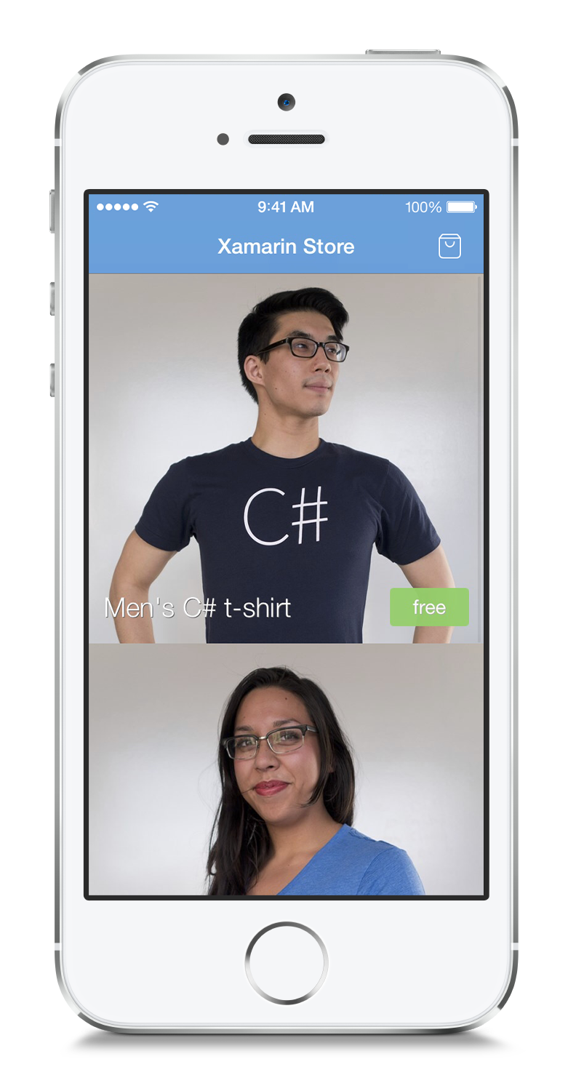
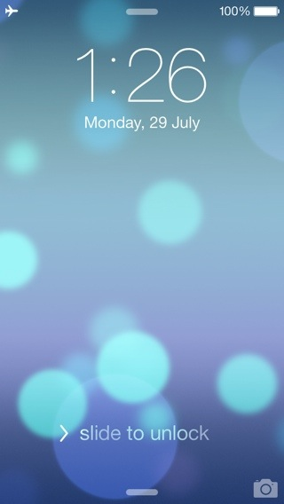
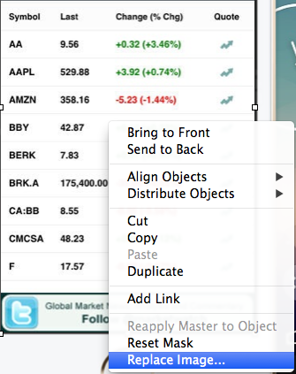
Adding screenshots to devices
Replace device screens by right-clicking on the screen and choosing “Replace Image…”
Notes:
Device frames should be “templatized” for easy replacement of screenshots.

Slide 15
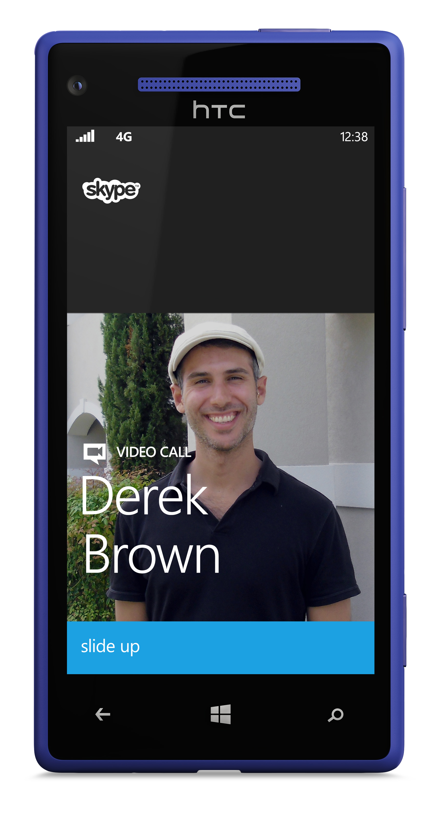
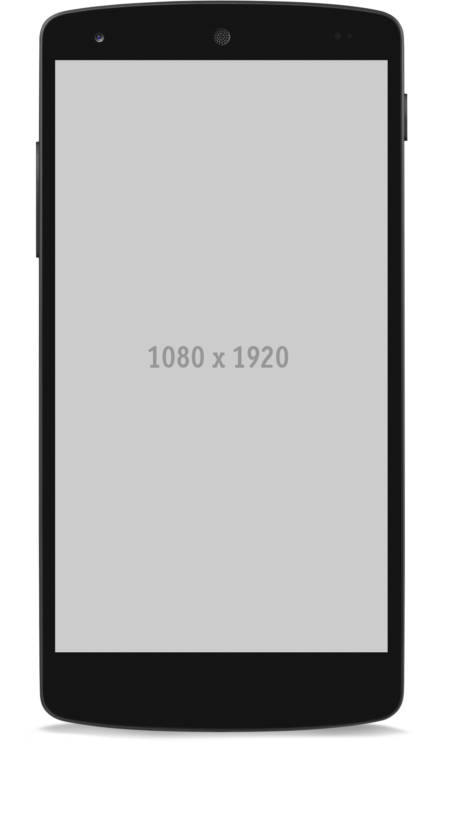
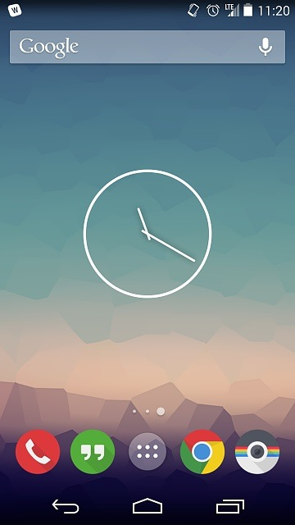
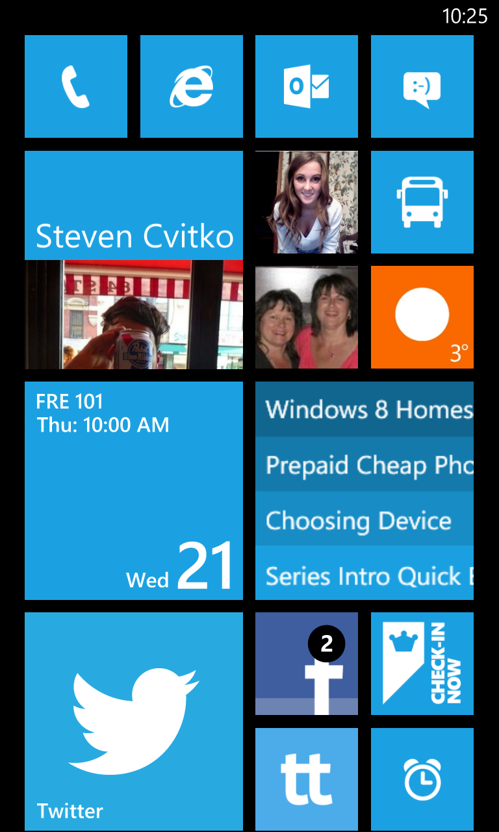
Notes:
Here are some frames for you to use.

Slide 16
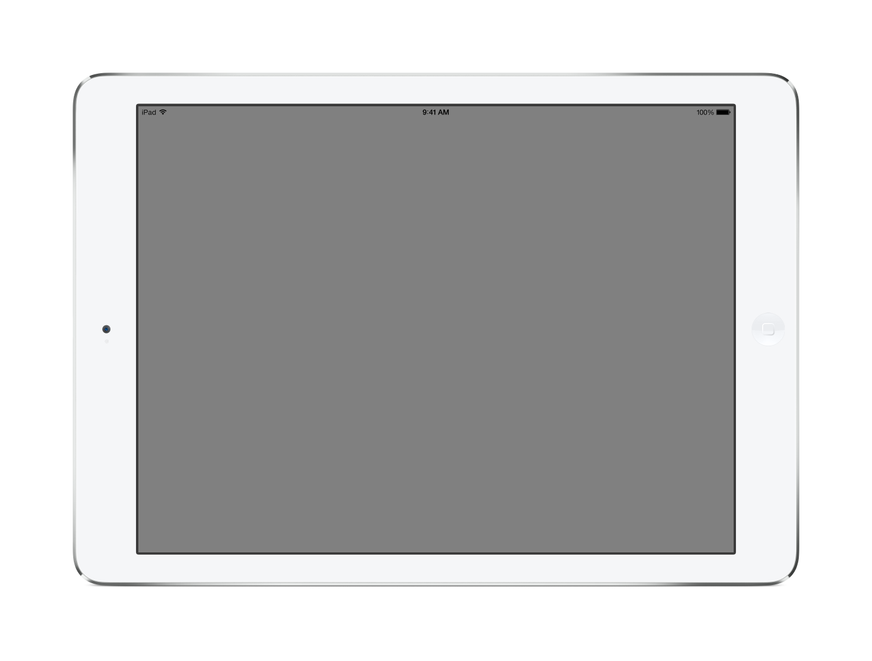
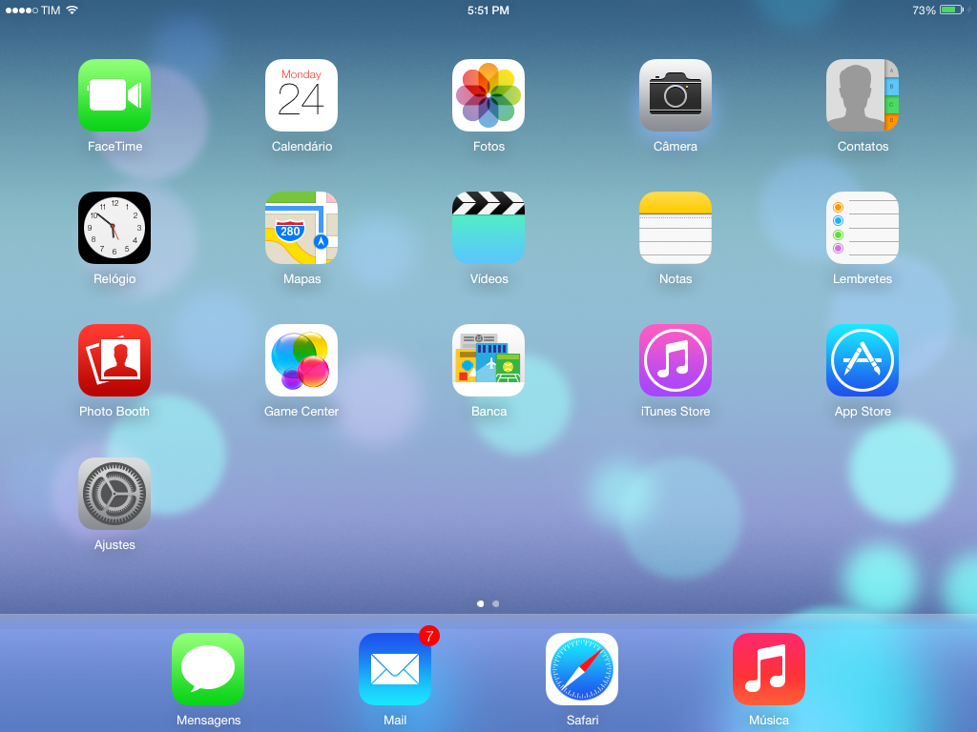

Slide 17
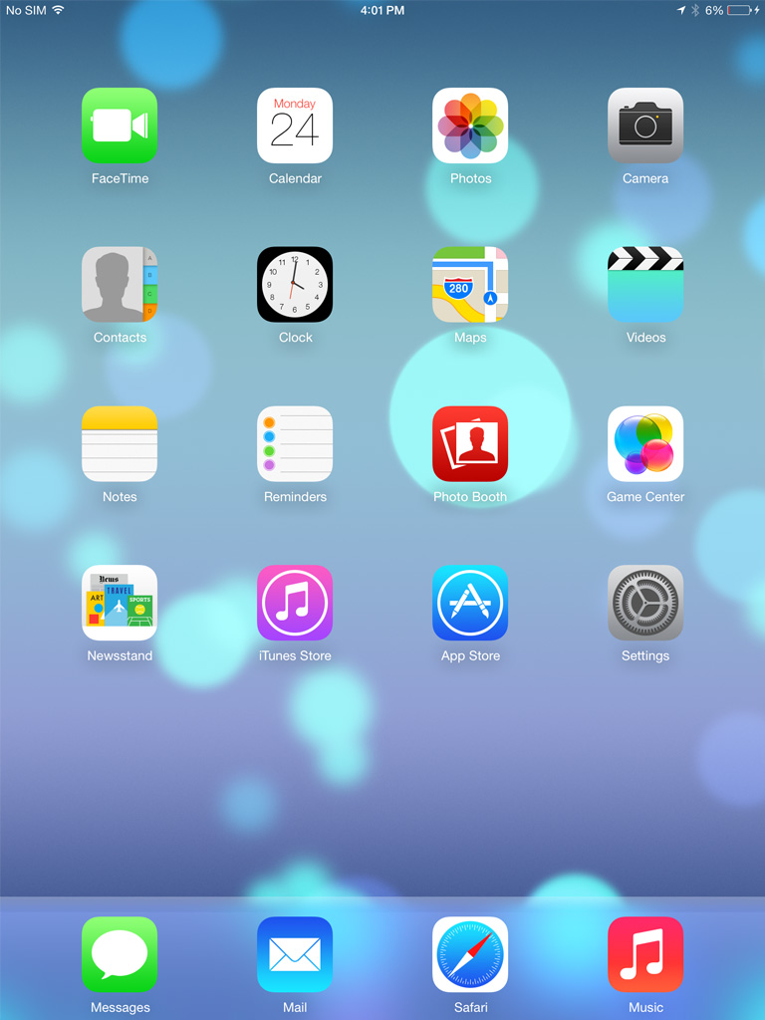

Slide 18
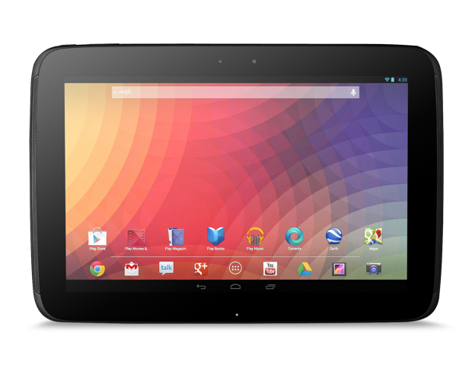


Slide 19
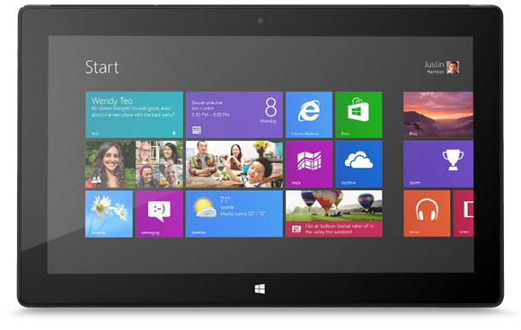
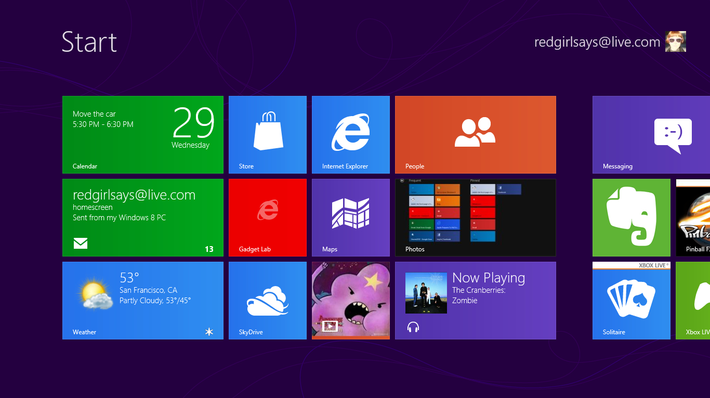

Slide 20

Icons, large and small
Large icons should be no bigger than 680px
The minimum size of icon is 80px
Minimum size
680px
80px
680px

Slide 21


Three icons in a row
When displaying three icons, make the icons 340px square with 200px between.
340px
200px
340px

Slide 22

Four icons in a grid
320px
200px
320px
88px

Slide 23










Light blue icons for reuse
System icon
Phone icon
Tablet icon
Icon ini gak precisely croping,
Gak berani replace soalnya gak punya gantinya yg mirip.
Notes:
Icons should be scalable. In Keynote, they are vector.

Slide 24


























More light blue icons for reuse
Functional icon
Common icon
Social icon
Notes:
Icons should be scalable. In Keynote, they are vector.

Slide 25












Dark icons for reuse
System icon
Phone icon
Tablet icon
Notes:
Icons should be scalable. In Keynote, they are vector.

Slide 26






























More dark icons for reuse
Functional icon
Common icon
Social icon
Notes:
Icons should be scalable. In Keynote, they are vector.

Slide 27












White icons for reuse
System icon
Phone icon
Tablet icon
Notes:
Icons should be scalable. In Keynote, they are vector.

Slide 28






























More white icons for reuse
Functional icon
Common icon
Social icon
Notes:
Icons should be scalable. In Keynote, they are vector.

Slide 29



Want more icons?
Check out http://ionicons.com/ – an MIT-licensed vector icon collection. Each icon is available as an SVG that you can open in Sketch, tweak the size, color, etc., and paste directly into Keynote.
Notes:
Need instructions for getting custom icons into PPTX. Skip slide if no instructions available.

Slide 30
Slide Samples

Slide 31

Presentation title goes here. Make it punchy.
Presenter Name
Presenter Title
@twitter_or_email
Notes:
Use your own photo here, don’t keep Craig.
PPT: image needs to be easily replaceable and correctly masked.

Slide 32
Section Heading
Notes:
To separate logical sections of your presentation. Use this to take a breath, a drink of water, give your audience some time to process.

Slide 33

Text with big image
Image dalam bentuk crop2an, kalo di klik kanan-change picture, gak bisa auto crop, jadi yang bersangkutan
harus manual crop.
Subtitle 60pt
Content 45pt
Notes:
Add your own title, subtitle, and content; then replace the image and you have a cool slide!
PPT: image needs to be easily replaceable and correctly masked.

Slide 34
Text with big image
Image dalam bentuk crop2an, kalo di klik kanan-change picture, gak bisa auto crop, jadi yang bersangkutan
harus manual crop.
Subtitle 60pt
Content 45pt
Notes:
Add your own title, subtitle, and content; then replace the image and you have a cool slide!
PPT: image needs to be easily replaceable and correctly masked.

Slide 35
Notes:
This is an example of a full-bleed photo slide. It creates a nice effect–sprinkle some of these throughout your presentation.

Slide 36
Photos separated by gaps
Image dalam bentuk crop2an, kalo di klik kanan-change picture, gak bisa auto crop, jadi yang bersangkutan
harus manual crop.
This text shape has no fill. It uses the same default interior margins as content tiles
Align all text blocks to the content tiles interior margins
Text can be used on, above or below photos.
Notes:
Images should all be the same size. Use image masks to “crop” irregular images within Keynote.
PPT: images need to be easily replaceable and correctly masked.

Slide 37
Title Size 80pt
Subtitle
Content 45pt
Sed diam nonumy eirmod
Tempor invidunt aliquyam erat
Labore et dolore magna
At vero eos et accusam
Et justo duo dolores
Content 45pt
Sed diam nonumy eirmod
Tempor invidunt aliquyam erat
Labore et dolore magna
At vero eos et accusam
Et justo duo dolores
Notes:
This slide is your bread-and-butter.

Slide 38
Title Size 80pt
Subtitle
Content 45pt
Sed diam nonumy eirmod
Tempor invidunt aliquyam erat
Labore et dolore magna
At vero eos et accusam
Et justo duo dolores
Content 45pt
Sed diam nonumy eirmod
Tempor invidunt aliquyam erat
Labore et dolore magna
At vero eos et accusam
Et justo duo dolores

Slide 39
Title Size 80pt
Subtitle
Content 45pt
Sed diam nonumy eirmod
Tempor invidunt aliquyam erat
Labore et dolore magna
At vero eos et accusam
Et justo duo dolores
Content 45pt
Sed diam nonumy eirmod
Tempor invidunt aliquyam erat
Labore et dolore magna
At vero eos et accusam
Et justo duo dolores

Slide 40
Title Size 80pt
Subtitle
Content 45pt. Duis autem vel eum iriure dolor in hendrerit in vulputate velit esse molestie consequat, vel illum dolore. Duis autem vel eum iriure dolor in hendrerit in vulputate velit esse molestie consequat, vel illum dolore. Duis autem vel eum iriure dolor in hendrerit in vulputate velit esse molestie consequat, vel illum dolore.

Slide 41
Title Size 80pt
Subtitle
Content 45pt. Duis autem vel eum iriure dolor in hendrerit in vulputate velit esse molestie consequat, vel illum dolore. Duis autem vel eum iriure dolor in hendrerit in vulputate velit esse molestie consequat, vel illum dolore. Duis autem vel eum iriure dolor in hendrerit in vulputate velit esse molestie consequat, vel illum dolore.

Slide 42
Title Size 80pt
Subtitle
Content 45pt. Duis autem vel eum iriure dolor in hendrerit in vulputate velit esse molestie consequat, vel illum dolore. Duis autem vel eum iriure dolor in hendrerit in vulputate velit esse molestie consequat, vel illum dolore. Duis autem vel eum iriure dolor in hendrerit in vulputate velit esse molestie consequat, vel illum dolore.

Slide 43
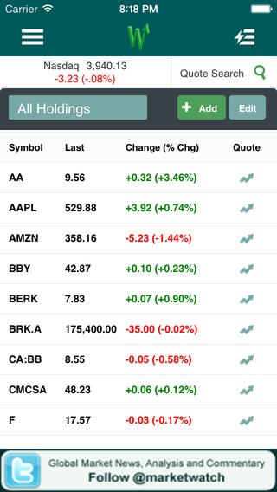
Title Size 80pt
Subtitle
MVVM pattern
Xamarin.Mobile
Signature control from Component
StoreSQLite for storage on all 3 platforms
Image dalam bentuk crop2an, kalo di klik kanan-change picture, gak bisa auto crop, jadi yang bersangkutan
harus manual crop.
Notes:
PPT: images (WITHIN FRAMES) need to be easily replaceable and correctly masked.

Slide 44
Title Size 80pt
App Features
Location-based assignments / routing
Time recording
Camera capture of work
Signature capture
Cross-Platform Technique
MVVM pattern
Xamarin.Mobile
Signature control from Component
Image dalam bentuk crop2an, kalo di klik kanan-change picture, gak bisa auto crop, jadi yang bersangkutan
harus manual crop.
Notes:
PPT: images (WITHIN FRAMES) need to be easily replaceable and correctly masked.

Slide 45
1,500,000
Users and growing
Notes:
Add label text box to master

Slide 46
1,500,000
Users and growing
Notes:
Add label text box to master

Slide 47

“Xamarin.Mac helps me tap into the Mac market with better, faster results.”
Image dalam bentuk crop2an, kalo di klik kanan-change picture, gak bisa auto crop, jadi yang bersangkutan
harus manual crop.
Name
Title and Company
Notes:
You may not use the photo of Jessica; find your own quote author photos.
PPT: image needs to be easily replaceable and correctly masked.

Slide 48
“I knew that Xamarin‘s performance advantages over other cross platform tools and its rock-solid support for all of the iOS APIs were just what this project needed.”
Image dalam bentuk crop2an, kalo di klik kanan-change picture, gak bisa auto crop, jadi yang bersangkutan
harus manual crop.
Name
Title and Company
Notes:
You may not use the photo of Jessica; find your own quote author photos.
PPT: image needs to be easily replaceable and correctly masked.

Slide 49
“Xamarin offers the best of all worlds. We deliver high performance, native apps that, until Xamarin, were only possible with Objective-C and Java. Sharing over 50,000 lines of code across platforms gives us more time to spend on great user experiences.”
Image dalam bentuk crop2an, kalo di klik kanan-change picture, gak bisa auto crop, jadi yang bersangkutan
harus manual crop.
Name
Title and Company
Notes:
You may not use the photo of Jessica; find your own quote author photos.
PPT: image needs to be easily replaceable and correctly masked.

Slide 50
Bar Chart Sample
Notes:
PPT: charts must be live

Slide 51
Pie Chart Sample 80pt
Text
Text
Text
Text
Text
Notes:
PPT: charts must be live

Slide 52
Demo

Slide 53
Ending Slide
Presenter Name
@twitter_or_email

